Slide 1



Matrix Models in Population Dynamics: Exploring Structure and Applications
By Aryaman, Siddharth and Sujal
Team 49

Slide 2

This project applies linear algebraic techniques, including Leslie matrices, transition matrices, and Markov chains, to analyze and model population dynamics. By utilizing matrix operations and eigenvalue analysis, it aims to gain valuable insights into fields such as population ecology and epidemiology, which involve the study of dynamic systems.

Slide 3

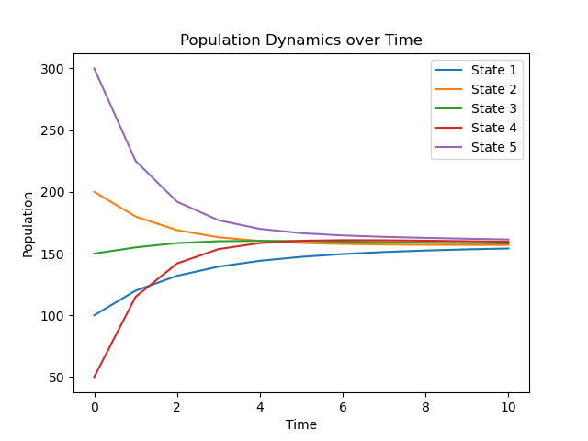

Population Dynamics Over time
Markov chains model population dynamics by analyzing transitions between states, aiding in predicting trends, understanding impacts, and addressing population management challenges in various fields.

Slide 4
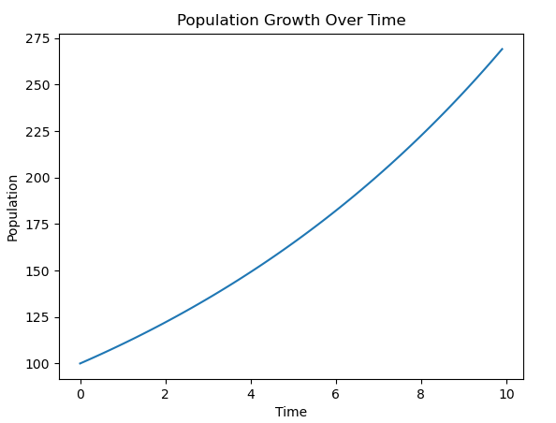
Factors affecting population growth
TIME

Slide 5
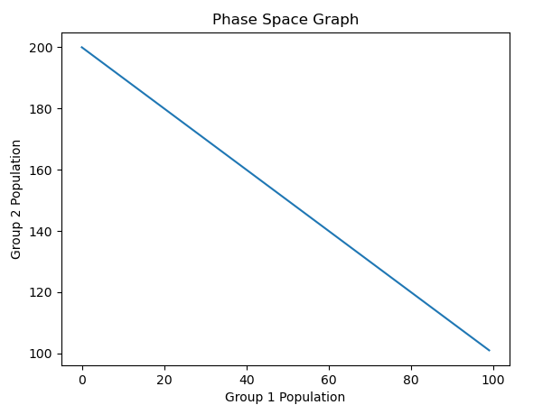
Factors affecting population growth
SPACE

Slide 6
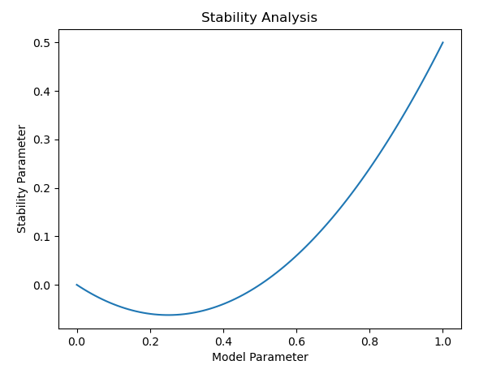
Factors affecting population growth
STABALITY

Slide 7
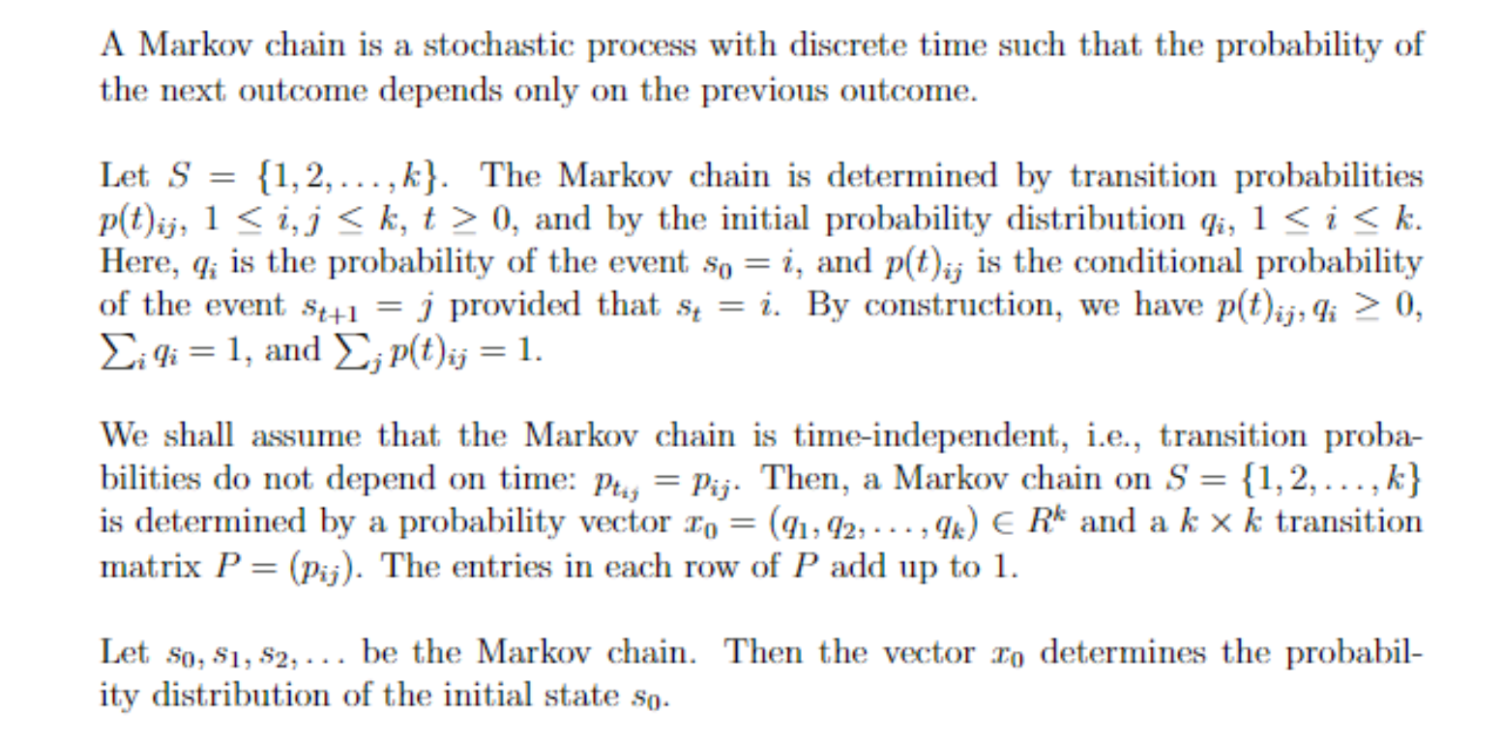
Markov Chain

Slide 8
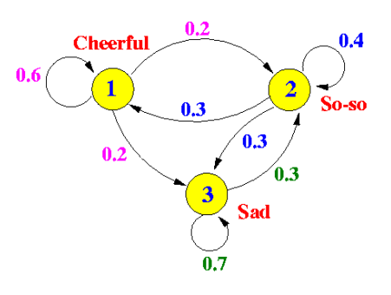
Markov Chain
We can visualize Markov chains with directed graphs.
• Vertices of the graph represent the states (entries of a vector).
• Arrows of the graph represent the transitions and their probability.
• We can write the transition probabilities into a stochastic matrix P .

Slide 9
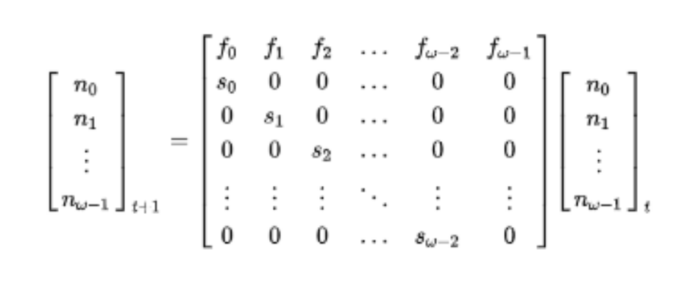
Leslie Model
The Leslie matrix, a popular model in population ecology, describes age-structured population growth. It divides the population into age classes and uses a square matrix to project population changes over time. By multiplying the population vector with the Leslie matrix, the population vector for the next time step is obtained.

Slide 10
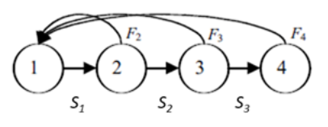
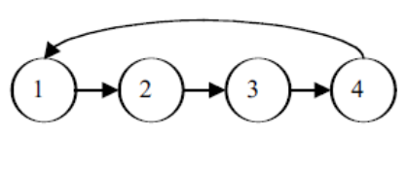
Stable Age Distibution
A population's age-class structure is depicted using circles representing different age classes. Horizontal arrows show survival probabilities between age classes, while curved arrows represent births entering the first age class. Age classes 2, 3, and 4 are capable of reproduction, while age class 1 does not reproduce. Modification would be necessary if only age class 4 individuals reproduced.

Slide 11


SIR Model
S: Susceptible/Healthy
I: Infected
R: Recovered/Immune

Slide 12
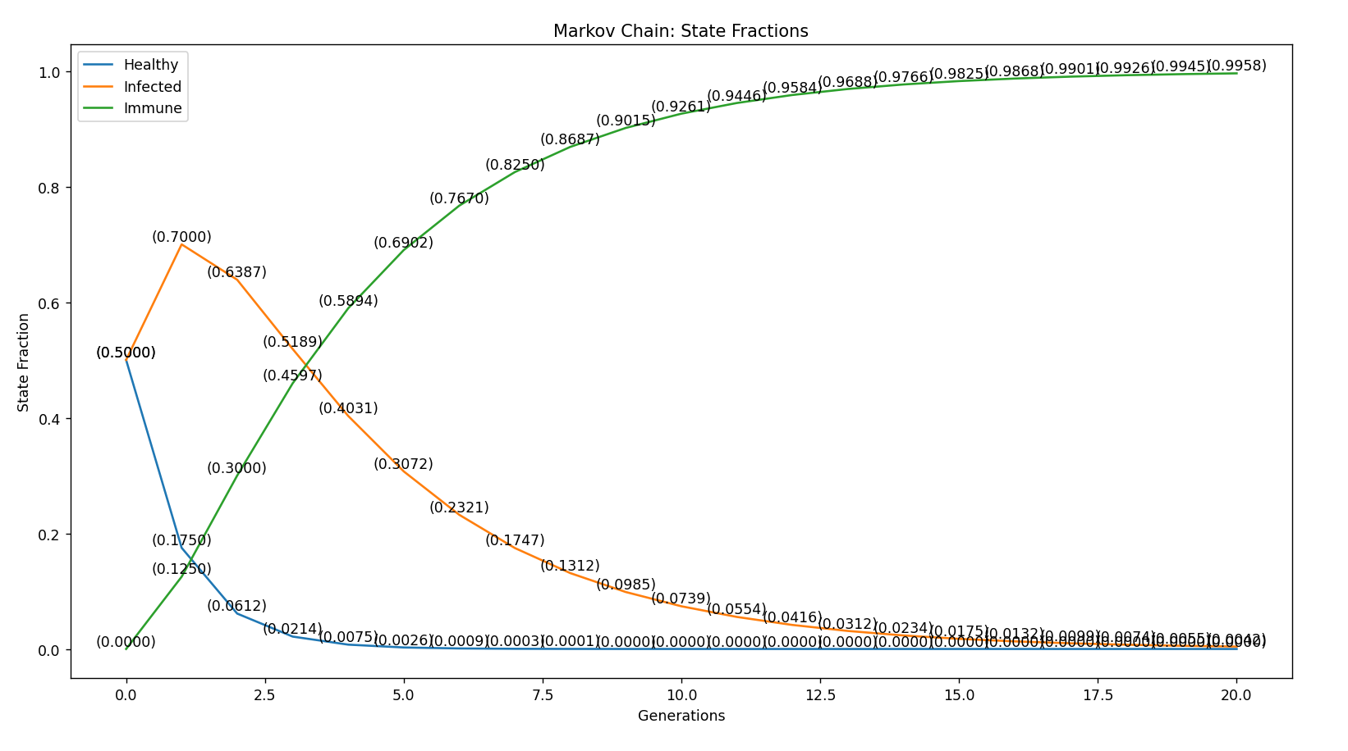
import numpy as np
import matplotlib.pyplot as plt
def markov_chain(transition_matrix, initial_states, generations):
states = np.zeros((generations + 1, 3))
states[0] = initial_states
for i in range(generations):
states[i+1] = np.dot(states[i], transition_matrix)
return states
def plot_state_fractions(states):
generations = len(states)
labels = ['Healthy', 'Infected', 'Immune']
for i in range(3):
plt.plot(range(generations), states[:, i], label=labels[i])
for j in range(generations):
plt.annotate(f'({states[j, i]:.4f})', (j, states[j, i]), ha='center', va='bottom')
plt.xlabel('Generations')
plt.ylabel('State Fraction')
plt.title('Markov Chain: State Fractions')
plt.legend()
plt.show()
# Example usage
# Define the transition matrix
transition_matrix = np.array([[0.35, 0.65, 0],
[0, 0.75, 0.25],
[0, 0, 1]])
# Define the initial matrix S0
initial_states = np.array([0.5,
0.5,
0])
generations = 20
states = markov_chain(transition_matrix, initial_states, generations)
plot_state_fractions(states)

Slide 13
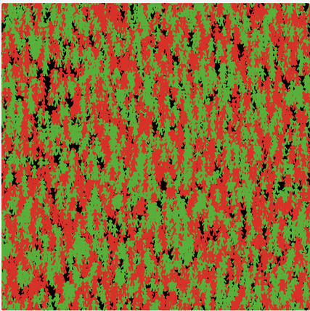
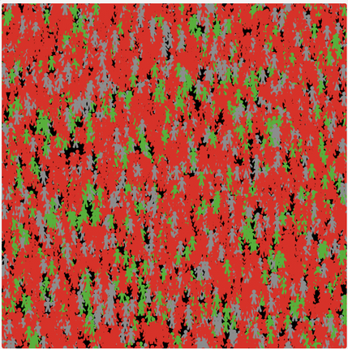
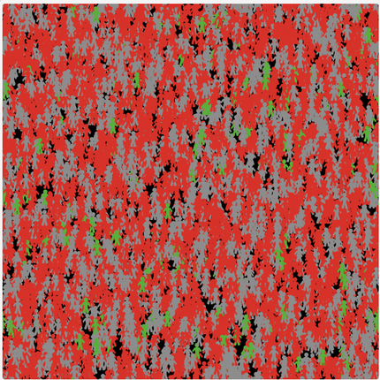
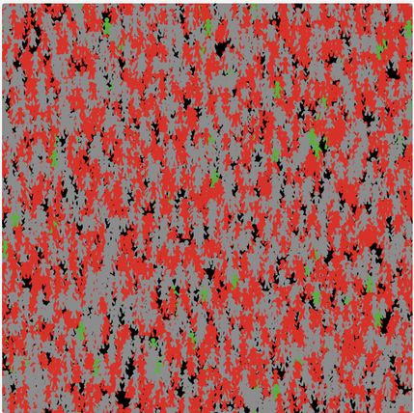
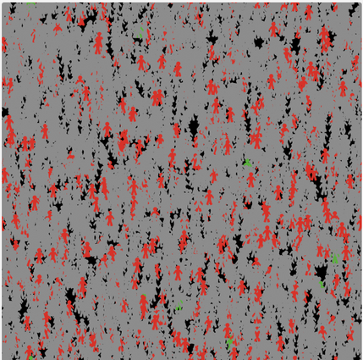
For Population size 5000
week 0
week 1
week 2
week 3
week 4

Slide 14
Case Study: Week 1 and Week 2
 | Predicted Week 1 | Actual Week 1 | PredIcted Week 2 | Actual Week 2
S | 0.175 | 0.127 | 0.0612 | 0.0527
I | 0.7 | 0.6922 | 0.6387 | 0.6046
R | 0.125 | 0.1808 | 0.3 | 0.3428

Slide 15
Population Ecology Network: Food Web

Slide 16
Topics Covered:
The Great Salt Lake Ecosystem
Calculation of Number of Direct Food Sources
Calculation of Number of Indirect Food Sources
Potential Food Chains
Structural Diversity
Determining Importance of Species in Coextinction

Slide 17
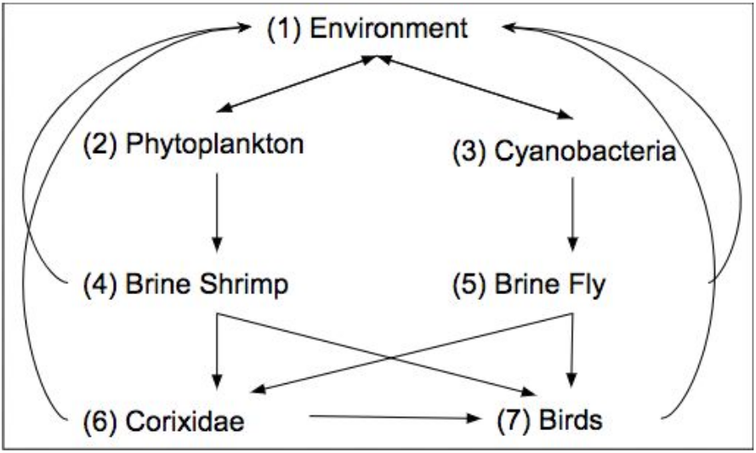
The Great Salt Lake Ecosystem

Slide 18
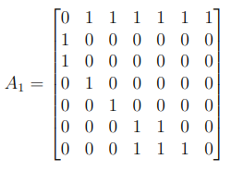
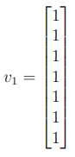
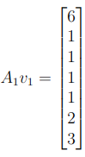
Calculation of number of Direct Food Sources
A1 represents the adjacency matrix of food web. Multiplying it with v1 gives A1v1 which is the number of direct food sources for all species.

Slide 19
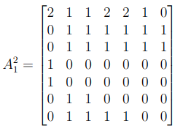
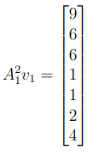
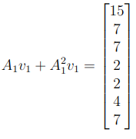
Calculation of number of Indirect Food Sources
Multiplying A1^2 with v1 gives A1^2.v1 which is the number of indirect food sources for all species. Summing up direct and indirect sources, we get total number of food sources sources

Slide 20
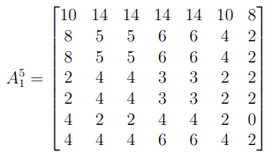
Potential Food Chains
Trophic level of The Great Salt Lake Food Web is 5. Therefore, A1^5 gives the total number of possible food chains from 1st trophic level to last trophic level.

Slide 21
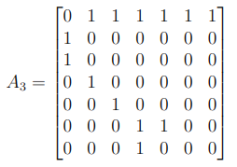
Structural Diversity
A3 is the adjacency matrix of the food web when we restrict birds to eat only brine shimp.
Its dominant eigenvalues shows that as the feeding options are limited, ecosystem's robustness decreaases.

Slide 22
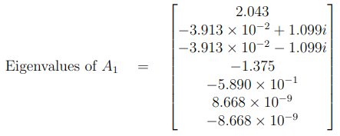
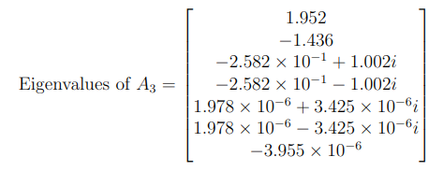
As the dominant eigenvalue has decreased on moving from A1 to A3, therefore we can say that robustness of the ecosystem has decreased.

